Slide 1


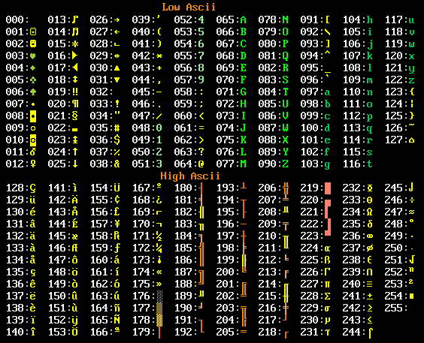
Strings and Streams
Representing Text, Working with Streams from Files and Strings
Zhivko Petrov
A guy that knows C++

Slide 2

Table of Contents
Representing Text in Computers
C++ Text Representation
C-Strings
The std::string class
Streams
The std::stringstream
Streaming to/from Files

Slide 3

Representing Text in Computers
Bytes, Code Points, Encoding

Slide 4
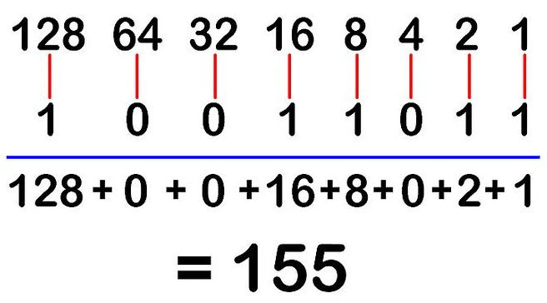
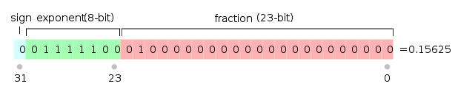
Representing Text in Computers
Data is bytes of 1s and 0s
Interpreted in different ways
Interpretation & size = data type
Ways we interpret bytes:
Binary number -> integer types
IEEE754 -> floating-point types
Binary "code point" -> char types
Characters (text) is just another interpretation of binary data

Slide 5
Representing Text in Computers
Text is just a sequence of characters
A character (letter, symbol, etc.) is just one or more bytes
The binary representation of a number
Interpreted as a code point from a character set (charset)
Character set – a group of characters (Latin, Cyrillic, etc.)
Code point – unique number assigned to a character in a charset
E.g. ASCII code point 65 (0x41) is 'A' (English capital letter A)

Slide 6


Character Sets & Unicode
ASCII is the base charset – code points from 0 to 127
English letters, digits, punctuation, control symbols (e.g. tab)
"Extended ASCII" – code points from 128 to 255
Different charsets use those codepoints for different characters
E.g. Windows: Cyrillic code point 211 (0xD3) is У
But Windows: Greek code point 211 (0xD3) is Σ
Unicode unifies charsets to represent all the world's characters
E.g. У is 1059 (U+0423) and Σ is 931 (U+03A3)

Slide 7
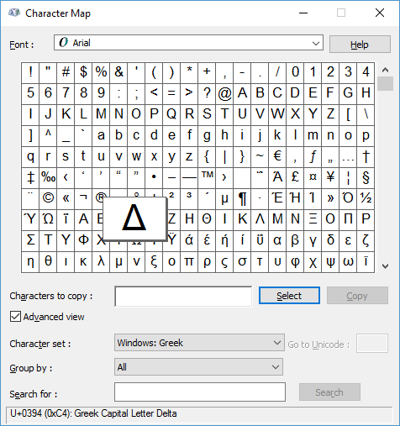
Representing Text in Computers
LIVE DEMO

Slide 8
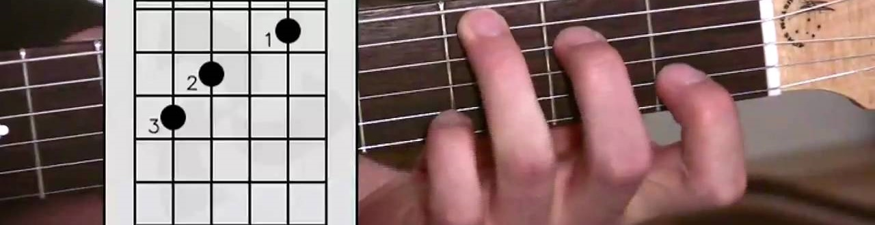
C++ Text Representation
C-Strings and std::string class

Slide 9
C++ Text Representation
C++ has good native support for the ASCII charset
char data type (usually) covers code points 0 to 255
We'll discuss Unicode later
Text types (sequences of characters) are called strings
C++ has two standard ways of working with text
Character arrays, aka C-Strings (legacy from the C language)
The C++ std::string – a "smart" wrapper of a C-String

Slide 10
char Arrays, aka C-Strings
An array of char, e.g. char str[], with the following rules:
Should be null-terminated, i.e. end with '\0', which is char(0)
'\0' counts as an element – it affects array size
Null-terminator tells C++ where the string ends
C++ arrays don't know their size, remember?
Char arrays with NO null-terminator are NOT used as strings
E.g. don't use cin, cout, or C-String functions
Can still use like an array of any other data type

Slide 11
Using C-Strings
Initialization can happen with array initializer or literal
If using normal array initializer, don’t forget the ‘\0’ at the end
cin & cout can directly write to and read from C-Strings
cout prints until it reaches '\0'
cin works correctly only if array can fit entered data
char text[16] = {'C','+','+',' ','P','r','o','g','r','a','m','m','i','n','g','\0'};
char sameText[] = {'C','+','+',' ','P','r','o','g','r','a','m','m','i','n','g', 0};
char sameTextAgain[] = "C++ Programming";
char sameTextYetAgain[16] = "C++ Programming";
char arr[100];
cin >> arr;
cout << arr << endl;

Slide 12
C-Strings Basics
LIVE DEMO

Slide 13
Quick Quiz
TIME:
What will the following code print?
It won’t – there will be a compile-time error
behavior is undefined
First line abc Second line def
First line abc, second line is undefined
char line1[4] = {'a', 'b', 'c'};
char line2[] = {'d', 'e', 'f'};
cout << line1 << endl;
cout << line2 << endl;

Slide 14
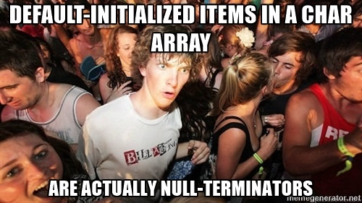
C++ Pitfall: NON-Terminated C-Strings
Most C-String compatible code will expect a null-terminator when using a C-String. If there is none, the code can’t know where the string ends – it just continues on until it reaches null somewhere in memory
But, if you give less items to array initializer than array size is – the remaining items get default values, which for char is exactly the null-terminator

Slide 15
Some C-String Built-in Functions
C-String functions are defined in the <cstring> header
strcat(destination, source)
Appends (concatenates) source C-String into destination C-String
destination needs to be long enough for source + null-terminator
strlen(str)
Returns length of C-String in str (based on the null-terminator)
strstr(str, search)
Returns the address (pointer) of search in str, NULL if not found
int index = strstr(str, search) - str; gets you the index

Slide 16
C-String Built-in Functions
LIVE DEMO

Slide 17
The std::string Class
The C++ Way for Working with Text

Slide 18
The std::string Class
The C++ string encapsulates a null-terminated C-String
#include<string>
Declare like a normal variable, e.g. string s;
Empty ("", size 0) if only declared (it gets default-initialized)
Can be initialized with C-String or string literal
string theFoxPart = "the quick brown fox";
string theActionPart("jumps over");
char dogPartCString[] = "the lazy dog";
string sentence = theFoxPart + string("---") +
theActionPart + string(3, '-')
+ dogPartCString;

Slide 19
std::string Basics
C++ Strings can be used with cin/cout
size() & length() return the number of chars
The [] operator is supported – similar to [] for a char array
The + operator concatenates two strings
string name;
cin >> name; cout << name;
string hello = "hello";
for (int i = 0; i < hello.size(); i++)
cout << hello[i] << endl;
hello[1] = 'a';
cout << hello << endl; //hallo
string helloName = hello + string(" ") + name;
cout << helloName << endl; // e.g. "hello George"

Slide 20
std::string Basics
LIVE DEMO

Slide 21
std::string Comparisons and Search
Two strings can be compared with any comparison operator
operators <, <=, ==, >=, > compare the strings lexicographically
str.find(search) returns the index of search in the str
If search is not found, returns the string::npos value (-1)
string s1 = "cat", s2 = "canary";
if (s1 < s2) { cout << s1 << " is before " << s2 << endl; }
else { cout << s1 << " is after " << s2 << endl; }
cout<<"nar"<<" at index "<<s1.find("nar")<<" in "<<s2;

Slide 22
std::string Comparisons and Search
LIVE DEMO

Slide 23
std::string Find All Occurrences
The find(search, index) overload takes a start index
The search starts from that index (ignores results before it)
string s = "aha"; cout << s.find("a", 1); prints 2
We can use this to search all occurrences of a substring
Each time search from after the last index where we found it
string str = "canary";
int foundIndex = str.find("a");
while (foundIndex != string::npos) {
cout << foundIndex << endl;
foundIndex = str.find("a", foundIndex + 1);
}

Slide 24
std::string Substring, Erase, Replace
substr(index, length) returns a new string
With length characters, starting from index
string s = "abc"; cout << s.substr(1,2); prints bc
erase(index, length) changes a string by removing chars
Removes length characters, starting from index
string s = "abc"; s.erase(1,2); cout << s; prints a
replace(index, length, str) changes a string by replacing
Characters in [index, index + length) replaced by str
string s = "abc"; s.replace(1,2,"cme"); cout << s; prints acme

Slide 25
std::string Substring, Erase, Replace
LIVE DEMO

Slide 26
Supporting Unicode in C++
char supports ASCII, string is a char array, no Unicode there
wchar_t and wstring
Variants of char & string that support system’s max code point
wchar_t on Unicode systems is 32-bit,
But on Windows wchar_t is 16-bit (UTF-16)
C++11 adds char16_t, char32_t, u16string & u32string
Built-in support is not very good – storing is ok, operations not
Best approach: use external libraries – QT, ICU, UTF8-CPP, etc.

Slide 27
Streams, Reading by Line, File I/O
std::stringstream, File Streams

Slide 28
C++ Streams
Streams offer an abstraction over incoming/outgoing data
E.g. cin and cout are abstractions of the console input/output
Practically speaking, streams are ways of reading/writing data
A stream can be constructed for any type of data container
Arrays, strings, memory
Files, network connections, the keyboard buffer, etc.

Slide 29
The std::stringstream
A stream that works on a string (instead of the console or a file)
#include<sstream>
Can read data from a string, can write data to a string
There are limited istringstream/ostringstream versions that only read/write respectively
Useful for working on a string “word-by-word”
E.g. reading in numbers from a string
E.g. creating a string with text and numbers

Slide 30
Reading with std::istringstream
istringstream is a limited stringstream than only reads
If you only want to read, use it instead of stringstream
Initialize istringstream by giving it a string to read from
From then on, use the stream just like cin
string str = "3 -2";
istringstream numbersStream(str);
int num1, num2;
numbersStream >> num1 >> num2;
int sum = num1 + num2;

Slide 31
Writing with std::ostringstream
ostringstream is a limited stringstream than only writes
Initialize ostringstream like a normal variable
From then on, use the stream just like cin
To get the string when you're done, call str()
ostringstream stream;
stream << "The sum is " << num1 + num2 << endl;
cout << stream.str();

Slide 32
Using std::stringstream
LIVE DEMO

Slide 33
Reading with getline() and Streams
getline(stream, targetStr) reads an entire line of text
Or until a delimiter char (additional parameter) is reached
From the provided stream and puts it into targetStr
Avoid mixing cin>> and getline(cin,…) http://stackoverflow.com/a/18786719
istringstream in("a word");
string line;
getline(in, line);
cout << line << endl; // a word
istringstream in("a.word");
string line;
getline(in, line, '.');
cout << line << endl; // a

Slide 34
Parsing Numbers from a Line
getline() already gives us the line as a string
Streams allow us to read strings/numbers separated by spaces
How do we know when to stop?
Streams can be used as a bool value
A stream is true if it still has something to read
A stream is false if the input ended, or if there was an error

Slide 35
Parsing Numbers from a Line
Read the line from cin into a string with getline()
Create an istringstream over that string
Read numbers from the stream while the stream is true
Add numbers to a vector to use them later
string line; getline(cin, line);
istringstream lineStream(line);
vector<int> numbers;
int currentNumber;
while (lineStream >> currentNumber) {
numbers.push_back(currentNumber);
}

Slide 36
Parsing Numbers from a Line
LIVE DEMO

Slide 37
Streams to and from Files
We saw that streams work the same way
Regardless of whether they are over the console, or a string
Same goes for files – you just have to create a file stream
#include<fstream>
ifstream is for reading, ofstream is for writing
Text reading/writing with same operators, functions, concepts
<< for writing, >> for reading, getline() reads line, etc.
Can be used as bool just like cin, cout and stringstream

Slide 38
Using Streams to/from Files
Declare the stream and open the file
Input streams expect the file to exist (enter error state otherwise)
Output streams create or overwrite the file on opening. There are parameters to tell the stream to append instead
ifstream input;
input.open("input.txt");
int a, b;
input >> a >> b;
input.close();
ofstream output;
output.open("output.txt");
output << a + b << endl; output.close();

Slide 39
Using Streams to/from Files
Declaration and opening can be shortened
close() is automatically called when stream goes out of scope
i.e. when the declaring block ends
Still, you should close explicitly if you're not using the stream
To make an output stream append instead of overwrite:
ofstream output("output.txt", fstream::app);
ifstream input("input.txt");
int a, b;
input >> a >> b;
input.close();
ofstream output("output.txt");
output << a + b << endl; output.close();

Slide 40

Summary
Text is a sequence of bytes interpreted by special rules
C++ has two standard ways of working with text
std::string is the C++ way for working with text
Knows size, has special operators and utility functions
C-Strings (char arrays) are the legacy C approach
Streams are abstractions for writing/reading data
Many more string & stream functions we didn't cover
http://www.cplusplus.com/reference/, http://en.cppreference.com

Slide 41
https://softuni.bg/trainings/courses

Slide 42












SoftUni Diamond Partners

Slide 43




SoftUni Organizational Partners

Slide 44




Trainings @ Software University (SoftUni)
Software University – High-Quality Education and Employment Opportunities
softuni.bg
Software University Foundation
http://softuni.foundation/
Software University @ Facebook
facebook.com/SoftwareUniversity
Software University Forums
forum.softuni.bg

Slide 45
License
This course (slides, examples, demos, videos, homework, etc.) is licensed under the "Creative Commons Attribution-NonCommercial-ShareAlike 4.0 International" license

